Slide 1
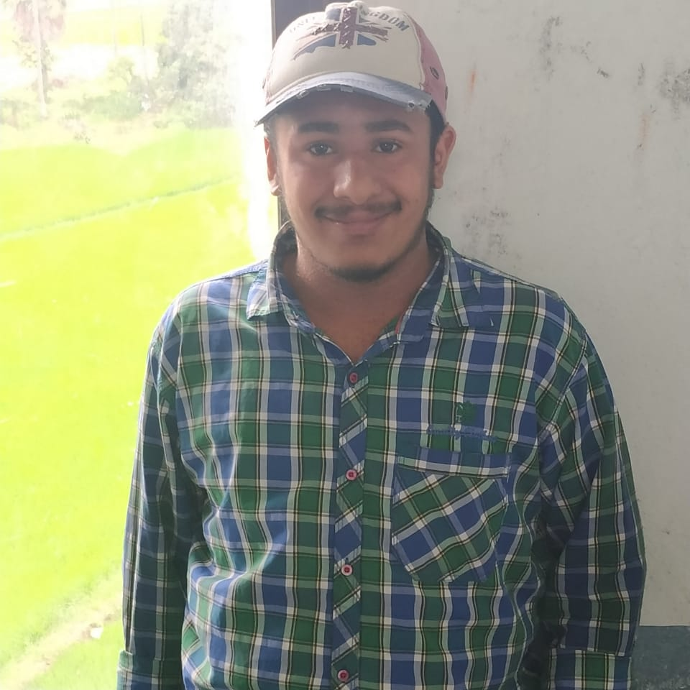



K V S Sai Santosh
Bachelor of Technology
Electronics and Communication : 2017 - 2021
Analyst/Software Engineer
Skills
JAVA
Spring Boot
Spring MVC
Spring Cloud
Full Stack
Spring
Angular
MongoDB
Database
No SQL database – MongoDB
SQL database -MySQL
Web Technologies
HTML5
CSS3
Javascript
AddOns
GitHub
Postman
Docker
Additional Details
Leadership
Communication Skills
Team management
Bangalore
K-v-s –sai.santosh@capgemini.com
+91 7095983073
A4
Full Stack Developer
Hands on experience in creating microservices with Springboot, Spring Security, Spring Cloud API Gateway, Eureka server.
Completed the training along with case study using Java Full Stack Angular as the technology.
Eager to improve myself by learning new technologies.
Team player who communicates effectively and works well with others to improve work output
Online Hotel Management System
Developed Online Hotel Management system Using Spring microservices and Angular with NoSQL as database.
Implemented multiple microservices using Spring Boot,Spring Cloud and connected them via discovery service i.e. Eureka server.
Frontend with Angular 12,Using Angular Material and Angular CLI for creating UI.
Database with MongoDB Atlas.
Version control using GitHub
Check out my work on GitHub & Video Profile

